Slide 1
Architecture Evaluation
Including ATAM

Slide 2
Architecture Metaphors
People do not think in abstractions & UML diagrams
  Majority
People think in stories, spaces, & metaphors
You open a laptop – what do you see?
Desktop – bridge between familiar & new
Metaphor
  Suggests what will follow
    Desktop → folders, documents, trash can,..
    Mailbox → messages, inbox, outbox,..
  Create a shared communication layer
    Every stakeholder sees the system simultaneously
→ fast learning
Notes:
desktop

Slide 3
Architecture Metaphors
Where does this break down?
  When you CHANGE the paradigm
  iPhone no more desktop & folders, only apps & taps
  Automobiles cannot associate with a horse
    Gears, windows, engine, transmission… - new concepts
What do YOU think the next paradigm shift will be?
Metaphors have blind spots
  Suggest properties the system does NOT have
    e.g. "cloud" implies infinite scale & reliability
  Hide complexity — mask important architectural detail
    e.g. "desktop" hides file permissions, OS complexity
  Can mislead stakeholders into wrong design assumptions
Notes:
Conversational ecosystems (interact via dialogs, not buttons)
Ambient systems (no interfaces, context-aware assistants)
AGI

Slide 4
Musings on Architecture
What makes good architecture? What makes it great one?
Examples of great:
  Buildings: Louvre glass pyramid (I.M. Pei)
    Must stand & bring feelings
  Devices: Apple (Jobs, Ives)
    Must work flawlessly & feel effortless
  Cars: Ferrari, Lamborghini, Tesla??
    Must be perfectly engineered & look fast
Common features – aesthetic appeal AND functional appeal
Ferrari – shape & aerodynamics, but shape IS aerodynamics
  2 sides of the same design

Slide 5
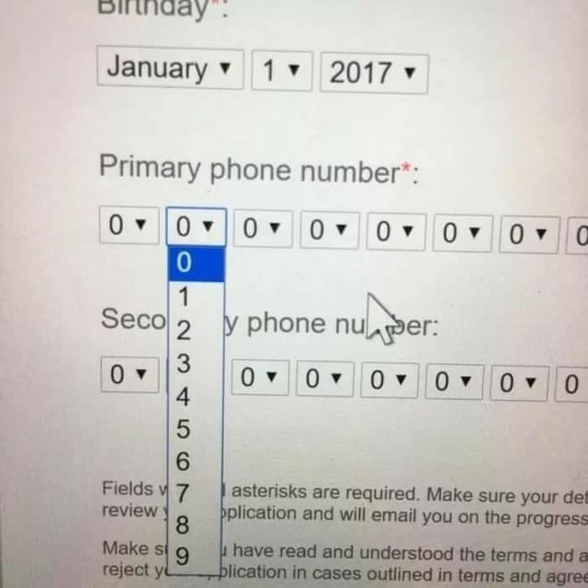
Musings on Architecture
What does it mean for software?
  Elegant API – not pretty syntax → minimalistic & powerful
  Poor implementation can destroy a brilliant architecture
    UX is bad, no matter what is under the hood
  Good implementation can’t save a poor architecture
    It will STILL ‘feel’ ugly
Consider combinations of a bad/good script & bad/good actor

Slide 6
Why Evaluate Software Architectures?
Earliest life-cycle artifact that defines significant design decisions:
  Choices and tradeoffs
  Affect critical QAs
  Hard to change after implementation
Software architecture process - combination of design and analysis
  Design – making decisions
  Analysis – understanding implications of those decisions
Architecture design involves tradeoffs in system qualities
  System qualities depend on architectural decisions
  Improving one quality often affects another quality
  Need to evaluate consequences
There are two commonly known approaches (we’ll look at both)
  ATAM (Architecture Tradeoff Analysis Method)
  SAAM (Scenario based Architecture Analysis Method)

Slide 7
Multiple areas to investigate
Requirements:
Domain functions
Quality attributes
Use cases
Architecture
Design Documentation
What we evaluate
Patterns
Tactics
Where we evaluate
System design
Module design
Communications
Where we deploy
Allocation mapping
Architecture
Drivers
Subset
Module
decomposition
design
Quality
Attribute
Scenarios
Design
decision
analysis
Architecture
Pattern
“Catalog”
Pattern and
design tactics
selection

Slide 8
Three Forms of Evaluation
Evaluation by the designer within the design process (self-review)
Evaluation by peers within the design process (peer-review)
Analysis by outsiders once the architecture is finished (external audit)
When do you evaluate architecture?
  Designing new system architecture
  Evaluating alternative candidate architectures
  Evaluating existing systems prior to committing to major upgrades
  Deciding between upgrade or replace
  Acquiring a system

Slide 9
Evaluation by the Designer
Evaluate after a key design decision or a completed design milestone
Test ideas against your own mental model:
  If I isolate this functionality, will I lose transactionality?
  If I introduce layers here, will it delay requests noticeably?
  If I introduce caching here, will I be able to invalidate it?
Strengths:
  Fast
  Aligned with your vision
Weaknesses:
  Blind spots & confirmation bias
  Underestimating external factors
How much analysis? Depends on:
  Importance of the decision
  Number of potential alternatives
  Desired quality (good enough vs perfect)

Slide 10
Peer Review
Can be peer reviewed, just as code
PR can be executed at any point of the design process
  Where a candidate architecture exists
Strengths:
  Fresh perspective & covered blind spots
  Cross-discipline expertise (e.g., UX, security, etc)
  Collective learning
Peer review process:
  Select QA scenarios to review (e.g. doubled number of requests – latency?)
  Architect presents the architecture to be reviewed to ensure reviewer understanding
    & walks through each scenario to explain how the architecture satisfies it
  Reviewers ask questions, problems are identified

Slide 11
Peer Review - Example
QA scenario:
  When an invalid token arrives
  System rejects it within 100 ms
Architect explains:
  API gateway validates token before routing
Potential questions:
  What if API gateway under a DDoS attack – will validation happen quickly?
  What if the external token verification service is slow right now?
  What happens if the auth service itself is unavailable — does the gateway fail open or closed?

Slide 12
Evaluation by “Outsiders”
Outside the development team or organization
  Credibility for stakeholders
  Objectivity
Strengths:
  Specialized knowledge (lacking in our team)
  Architectural experience (more than in our team)
Generally, evaluate the entire architecture
If they have more expertise, why not let them do the whole job?

Slide 13
Contextual Factors for Evaluation
Should be a structured process – answer these questions beforehand
  What artifacts are available? e.g.
    Models & views
    Decision rationale document (SWEN-261 design doc)
    QA scenarios
  Who performs the evaluation?
    Peer / outsiders
    Domain expertise & why (web system architect vs real-time embedded system)
  Which stakeholders are needed and will participate?
    DevOps / users / compliance officers / product owner / etc
    Can contribute scenarios / assess implications / make decisions (e.g., continue or change the approach)
  What stakeholders see the results?
    Visibility in the organization – depends on the goal (engineers, managers, etc)
  What are the business goals? Architecture looks good is not enough
    Does it meet QAs and requirements or not? Does it help to reach business goals?

Slide 14
Architecture Tradeoff Analysis Method (ATAM)
ATAM highlights trade-offs before it’s too late
Helps to discover:
  Risks – decisions that might create future problems in some QA
    e.g. DB in a potentially high-load system
  Non-risks – decisions that actively support important QAs
    e.g. redundancy to meet reliability goals
  Sensitivity points – decisions where a slight change makes a significant difference in some QA
    e.g. cache size change can affect latency drastically
  Trade-offs – decisions that improve one QA and worsen another
    e.g. encryption improves security, but affects performance
Not precise analysis – find potential conflicts between architectural decisions and predicted quality to identify possible design mitigations

Slide 15
ATAM Outputs
Presentation of the architecture — shared understanding of context, components, patterns, data flow, and deployment
Business goals — stakeholders re-align on shared goals (e.g. +15% retention through better performance)
Prioritized QA requirements — expressed as QA scenarios, focuses evaluation on what matters most
Risks, non-risks & risk themes — risk themes cluster related risks (e.g. recurring performance issues from centralized data access)
Decisions-to-QA mapping — traceability confirms every quality requirement has architectural backing
Sensitivity points & trade-offs — small changes with outsized QA impact, or one QA gained at another's expense

Slide 16
ATAM Context
Preconditions:
  Software architecture exists and is documented
  Prepare architecture and business presentations
    Need to explain how the architecture works
  Material is reviewed ahead of time
Evaluation team – 3-5 “outsiders”:
  Experienced architects
  Roles – team leader, moderator, scribe(s), questioners
Representative stakeholders and decision makers:
  System architects and lead developers
  Business and project management – can authorize architectural decisions
  End users, domain experts, and operations staff

Slide 17
ATAM Phases
Phase | Activity | Participants | Typical duration
0 | Partnership and preparation: Logistics, planning, stakeholder recruitment, team formation | Evaluation team leadership and key project decision-makers | Proceeds informally as required, perhaps over a few weeks
1 | Evaluation: Steps 1-6 | Evaluation team and project decision-makers | 1-2 days followed by a hiatus of 2-3 weeks
2 | Evaluation: Steps 7-9 | Evaluation team, project decision-makers, stakeholders | 2 days
3 | Follow-up: Report generation and delivery, process improvement | Evaluation team and evaluation client | 1 week

Slide 18
Tools and techniques to help
Checklists
  Every reasonable architecture should have…
  Based on
    Previous experience
    Domain
    Chosen patterns, deployment, context, etc (e.g., monolith vs microservices)
  Can be found online (e.g. OWASP Cheat Sheets)
Thought experiments
  What if…
Analytical Models
  e.g. calculate overall availability based on components' availability
Prototype and Simulations
See appendix (slides 26–27) for detailed reference notes on each technique

Slide 19
Class Activity (If time permits)
Run an ATAM for your project
Two “volunteers” from another team will serve as experienced architects for evaluation
Prepare “presentation” today – business drivers, architecture design, QA utility tree
Perform evaluation in the next class (step 6)
Document your results; risks, sensitivity points, tradeoffs, defects, overall assessment
Submit to the Activities/ATAM dropbox

Slide 20
ATAM Steps (Phase 1 – Steps 1-3)
Explain the ATAM process
  Explain evaluation method, participant roles, and expected outputs
Present business drivers
  Domain context
  High-level functions
  Prioritized QA requirements
  Any other architecture drivers
Present architecture
  Overview
  Technical constraints
  Architectural styles and tactics used to address quality attributes with rationale
  Most important views

Slide 21
ATAM Steps (Phase 1 – Steps 4-5)
Identify key places that address architectural drivers
  Identify predominant styles and tactics chosen
Generate QA utility tree – tool for evaluation
  Critical QA goals are high-level nodes
    Typically performance, modifiability, security, and availability
  Scenarios are the leaves
  Result:
    Characterization and prioritization of QA requirements
    High/Medium/Low importance for the success of the system
    High/Medium/Low difficulty to achieve (architect’s assessment)

Slide 22
ATAM Steps (Phase 1 – Step 6)
Analyze architectural approaches
  Use the utility tree (next slide) as a guide …
    Take one important QA (start with the highest priority)
    Ask how the architecture supports it
    Evaluate the answer
    Identify risks / non-risks / sensitivity points / trade-offs / issues
    Repeat for other QAs
Findings are summarized – have the right design decisions been made?

Slide 23
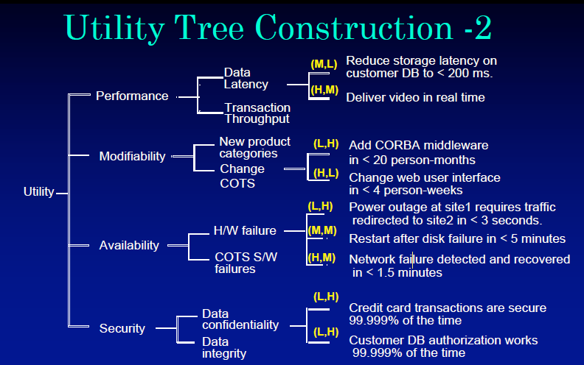
Utility Tree
Score: (importance, difficulty)
H = High
M = Medium
L = Low

Slide 24
ATAM Steps (Phase 2 – Steps 7-9)
Brainstorm and prioritize scenarios
  All stakeholders participate
  Phase 1 results are summarized to brief all stakeholders
  Stakeholders brainstorm scenarios important to them
  Generated scenarios are consolidated, compared to the utility tree, and prioritized
Repeat architecture analysis
Summarize and present results
  Architecture is updated based on findings

Slide 25
Appendix
Tools and techniques Details

Slide 26
Tools & Techniques Details
Checklists
Checklists have been proven as reliable tools for ensuring processes are correctly followed and all key tasks or questions are addressed. The human mind cannot remember all the details needed in complex designs — checklists capture that knowledge and ensure it is consistently applied.
Example: OWASP Cheat Sheets — a set of checklists for black box testing and security evaluation of web applications.
Also: The Open Group Architecture Review Checklist provides domain-specific evaluation criteria.
Thought Experiments
Informal analysis performed by an individual or a small group. While thought experiments may lack the rigor of analytical models, they are a valuable method for exploring designs early and quickly identifying potential issues.
Thought experiments encourage discovery of alternatives — free-associating ideas and challenging assumptions without the scripted structure of ATAM.

Slide 27
Tools & Techniques Details
Analytical Models
There exist a wide range of mathematical models that can be applied to address key architectural requirements.
  Markov and statistical models to understand availability
  Queuing and scheduling theory to understand performance
These models can provide key insights however there can be a steep learning curve to understanding the underlying theory and how to model the evolving software architecture with them.
Prototypes and Simulations
When fundamental questions cannot be adequately resolved by analysis methods a working prototype may be the only means to fully explore the decision space. Depending on what needs to be prototyped this can be an expensive task. However, it may be the only method of validating a design decision before fully committing to it.
Prototypes need to be approached with caution and a fundamental understanding of the end goal.

